Slide 1
MILESTONE 3:
Adaptive Intelligence & Recommendations

Slide 2
Objective
Main Goals
Analyze user wake-up behavior
Track challenge performance
Calculate habit performance
Automatically adjust challenge difficulty
Generate personalized recommendations
Display behavioral insights through analytics
Workflow
User Behavior → Analysis → Habit Score → Difficulty Adaptation → Recommendations

Slide 3
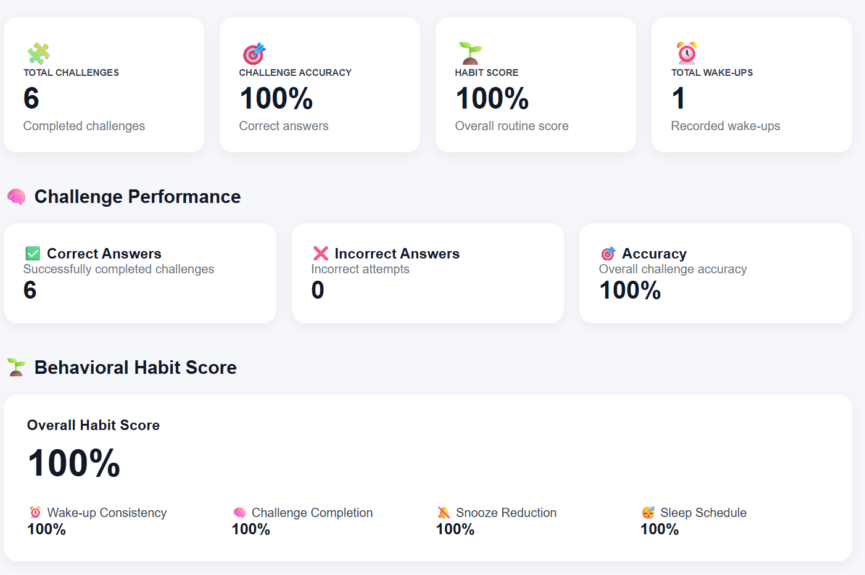
Behavioral Analytics
COGNIA collects and analyzes user behavior during wake-up sessions.
Data Tracked
Total wake-ups
Successful wake-ups
Snooze frequency
Snooze count
Challenge completion
Correct and incorrect answers
Challenge accuracy
Challenge difficulty
Wake-up history
Example
4 challenges → 100% accuracy → Good performance detected

Slide 4
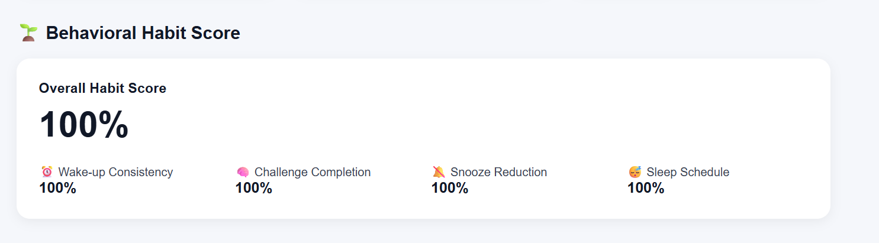
Habit Scoring
COGNIA calculates an overall Habit Score using multiple behavioral factors.
Weighted Scoring Model
Current Example
Wake-up Consistency: 100%
Challenge Completion: 100%
Snooze Reduction: 100%
Sleep Schedule: 100%
Overall Habit Score
100%

Slide 5
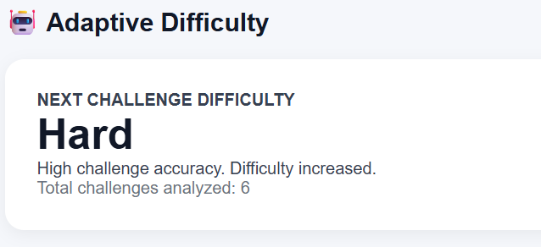
Adaptive Difficulty
COGNIA automatically adjusts the next challenge difficulty based on user performance.
Difficulty Levels
Beginner → Easy → Medium → Hard → Expert
Example from COGNIA
4 challenges completed
↓
100% challenge accuracy
↓
High performance detected
↓
Next Challenge: HARD
This helps maintain appropriate cognitive engagement.

Slide 6
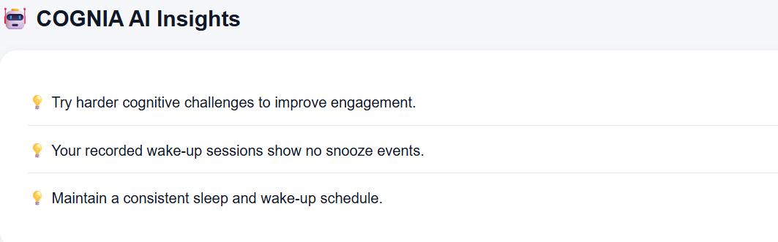
COGNIA AI Insights
The Recommendation Engine generates suggestions using the user's behavioral data.
Current Recommendations
Try harder cognitive challenges to improve engagement
Maintain a consistent sleep and wake-up schedule
No snooze events detected in recorded wake-up sessions
Purpose
Recommendations help users:
Improve wake-up habits
Maintain consistency
Improve challenge engagement
Follow better routines

Slide 7
Smart Analytics Dashboard
Key Results
Tracks challenge performance and wake-up behavior
Calculates a personalized Habit Score
Monitors snooze and wake-up consistency
Automatically determines the next challenge difficulty
Generates behavior-based AI recommendations
🎯 Result
The dashboard provides a clear view of the user's cognitive performance and wake-up habits, enabling COGNIA to deliver a personalized alarm experience.

Slide 8
THANK YOU

